Slide 1
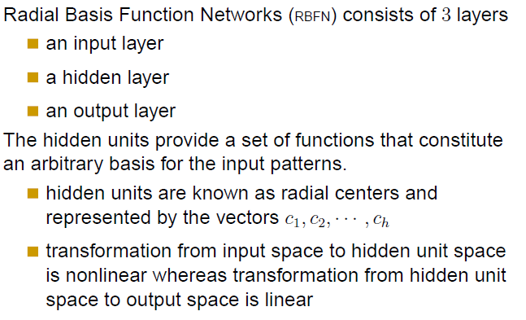

Radial Basis Function Networks

Slide 2
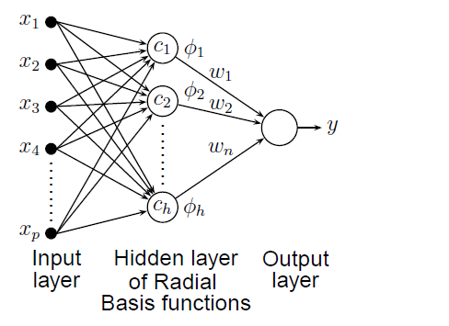
Radial Basis Function Networks

Slide 3
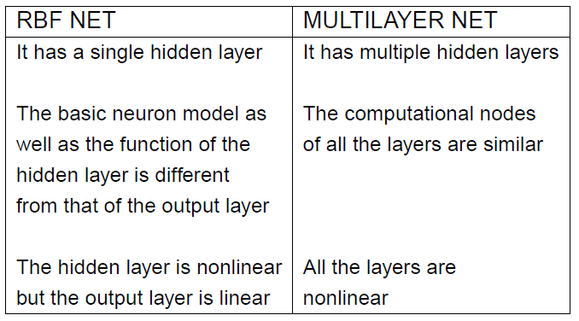
RBF VS MULTILAYER NET

Slide 4
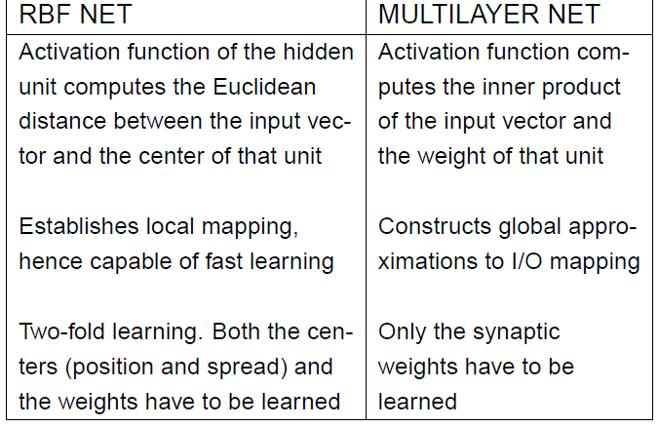
RBF VS MULTILAYER NET

